Slide 1
WELCOME TO MY NEW PROJECT

Slide 2


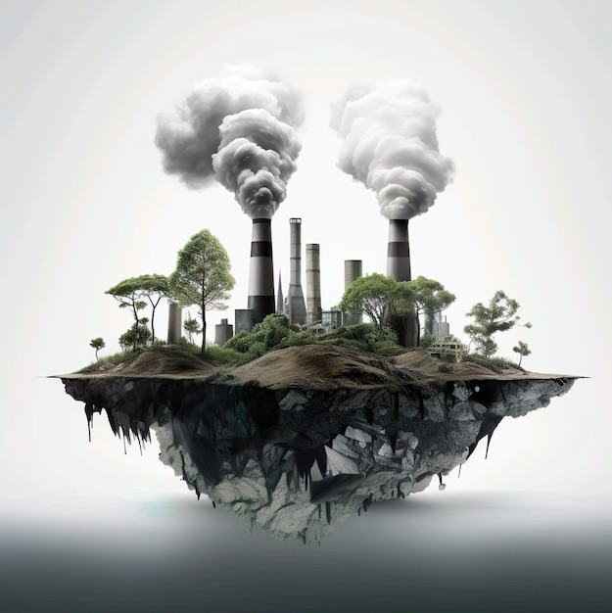
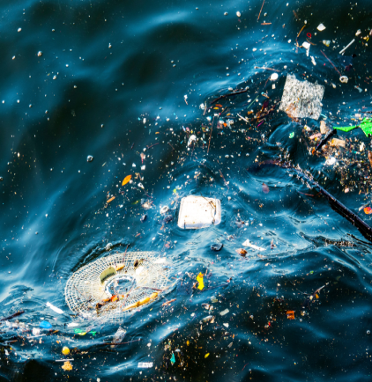
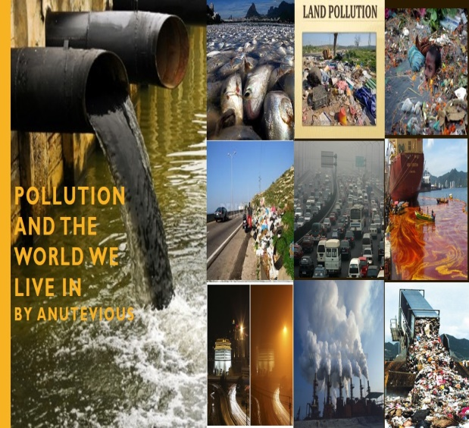
POLLUTION

Slide 3
TYPES OF ENVIRONMENTAL POLLUTION
AIR POLLUTION
WATER POLLUTION
SOIL POLLUTION
THERMAL POLLUTION
RADIOACTIVE POLOLUTION
NOISE POLLUTION
LIGHT POLLUTION

Slide 4
What is Water pollution ????
Water pollution occurs when harmful substances—often chemicals or microorganisms—contaminate a stream, river, lake, ocean, aquifer, or other body of water, degrading water quality and rendering it toxic to humans or the environment.
This widespread problem of water pollution is jeopardizing our health. Unsafe water kills more people each year than war and all other forms of violence combined. Meanwhile, our drinkable water sources are finite: Less than 1 percent of the earth’s freshwater is actually accessible to us. Without action, the challenges will only increase by 2050, when global demand for freshwater is expected to be one-third greater than it is now.

Slide 5
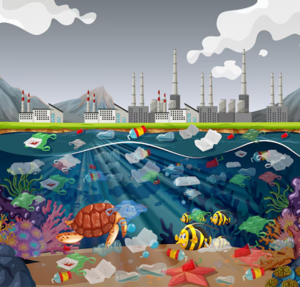
Causes of water pollution:
Industrial Waste. Industries and industrial sites across the world are a major contributor to water pollution. ...
Marine Dumping. ...
Sewage and Wastewater. ...
Oil Leaks and Spills. ...
Agriculture. ...
Global Warming. ...
Radioactive Waste.

Slide 6
What is Air pollution ???
Air pollution refers to the release of pollutants into the air—pollutants that are detrimental to human health and the planet as a whole. According to the World Health Organization (WHO), each year, indoor and outdoor air pollution is responsible for nearly seven million deaths around the globe. Ninety-nine percent of human beings currently breathe air that exceeds the WHO’s guideline limits for pollutants, with those living in low- and middle-income countries suffering the most. In the United States, the Clean Air Act, established in 1970, authorizes the U.S. Environmental Protection Agency (EPA) to safeguard public health by regulating the emissions of these harmful air pollutants.

Slide 7
CAUSES OF AIR POLLUTION:
“Most air pollution comes from energy use and production,” says John Walke, director of the Clean Air team at NRDC. Driving a car on gasoline, heating a home with oil, running a power plant on fracked gas: In each case, a fossil fuel is burned and harmful chemicals and gases are released into the air.
“We’ve made progress over the last 50 years in improving air quality in the United States, thanks to the Clean Air Act. But climate change will make it harder in the future to meet pollution standards, which are designed to protect health,” says Walke.
Even though you can’t see it, the air you are breathing is probably polluted. Worldwide, 9 out of 10 of us breathe air that is damaging our health. Invisible particles penetrate every cell and organ in our bodies, causing acute and chronic diseases, including asthma, strokes, heart attacks and dementia. Outdoor air pollution causes around 4.2 million early deaths every year.

Slide 8
WHAT IS SOIL POLLUTION ????
This invisible affliction appears when the concentration of pollutants on the surface becomes so high that it harms land biodiversity and endangers health, particularly through food. Activities such as stock breeding and intensive farming use chemicals, pesticides and fertilisers that pollute the land, just as happens with heavy metals and other natural and man-made chemical substances.
Soil pollution is a global threat that is particularly serious in regions like Europe, Eurasia, Asia and North Africa, as indicated by the Food and Agricultural Organization of the United Nations (FAO). The FAO also affirms that both intense and even moderate degradation is already affecting one third of the world's soil. Moreover, recovery is so slow that it would take 1,000 years to create a few centimetres layer of arable soil.

Slide 9
WHAT ARE THE CAUSES OF SOIL POLLUTION :
Rainfall and Flooding. Higher intensity of rainstorms is the main cause of soil erosion. ...
Agriculture. The farming practices are the major cause of soil erosion. ...
Grazing. ...
Logging and Mining. ...
Construction. ...
Rivers and Streams. ...
Heavy Winds. ...
Loss of Arable Land.

Slide 10
WHAT IS THERMAL POLLUTION ????
Human alterations to natural temperature regimes of freshwater habitats cause thermal pollution. Thermal pollution is any deviation from the natural temperature in a habitat and can range from elevated temperatures associated with industrial cooling activities to discharges of cold water into streams below large impoundments. Given that the metabolic rates of ectotherms are controlled by temperature, and that the vast majority of freshwater organisms are ectothermic, thermal pollution can strongly affect freshwater communities. Alterations to normal water temperature regimes have myriad biological effects, including interfering with temperature cues for spawning fishes, facilitating establishment of exotic species, and altering growth and development of aquatic organisms (Langford, 1990). Further, aquatic organisms evolved in relatively thermally buffered environments, and thus they are generally more sensitive to temperature fluctuations than are their terrestrial counterparts.
Temperature tolerances among species of freshwater organisms are highly variable, but all have an optimal range and low and high limits within which they can survive. Increases in temperature cause an increase in growth rate up to a point. Above some threshold, damage occurs. Because temperature governs rates at multiple levels of biological organization

Slide 11
CAUSES OF THERMAL POLLUTION:
Use of water for cooling. Many industrial processes produce a lot of heat. ...
Soil erosion. Soil erosion is the gradual wearing away of topsoil from the land. ...
Deforestation. ...
Urban runoff. ...
Natural causes. ...
Disruption of fish and amphibian habitats. ...
Decrease in dissolved oxygen. ...
Algal blooms.

Slide 12
WHAT IS NOISE POLLUTION ????
Noise pollution is a form of pollution which has become very deadly nowadays. This pollution is increasing only and creates an unsafe environment. Noise pollution is when the level of noise increases more than the normal level. When the amount of noise exceeds, it becomes dangerous for living beings. Moreover, these unpleasant sounds cause several disturbances and create an imbalance in the environment.
In other words, high volume noises are abnormal. As the world is advancing at a rapid rate, so is noise pollution. Technology has made things easier for people by creating appliances and devices for almost everything. You want to mix or grind something? It can be done with a mixer and blender. You are feeling hot? Simply turn on the AC or cooler. Do you want entertainment at home? You can watch television or play music. However, people don’t realize this comfort comes with harmful effects too. All the mentioned appliances contribute to noise pollution. They disturb the natural rhythm of life and fall in the category of a pollutant.

Slide 13
CAUSES OF NOISE POLLUTION :
As the world is turning to technology for their comfort, it is, at the same time, harming us. The industries no matter how big or small contribution to noise pollution. The equipment they use like compressors, exhaust fans, generators and more produce a lot of noise.
Similarly, the ever-increasing use of automobiles is a major cause of this pollution. Not only automobiles but other transport vehicles like airplanes, buses, bikes, trucks and more also are a part of it. People honk unnecessarily in the traffic and listen to loud music on the way which creates high levels of noise.
Furthermore, social events like marriages, parties, and religious functions in places like clubs, pubs, temples, halls and more create a lot of nuisance in the residential areas. In addition, the construction activities like mining, the building of flyovers, bridges and more also produce great noise.

Slide 14
WHAT IS LIGHT POLLUTION ???
Light pollution is the presence of unwanted, inappropriate, or excessive artificial lighting.
In a descriptive sense, the term light pollution refers to the effects of any poorly implemented lighting, during the day or night. Light pollution can be understood not only as a phenomenon resulting from a specific source or kind of pollution, but also as a contributor to the wider, collective impact of various sources of pollution.
Light pollution seen via a long-exposure shot Although this type of pollution can exist throughout the day, its effects are magnified during the night with the contrast of darkness. It has been estimated that 83 percent of the world's people live under light-polluted skies and that 23 percent of the world's land area is affected by skyglow.
The area affected by artificial illumination continues to increase.
A major side-effect of urbanization, light pollution is blamed for compromising health, disrupting ecosystems, and spoiling aesthetic environments. Globally, it has increased by at least 49% from 1992 to 2017.

Slide 15
CAUSES OF LIGHT POLLUTION
Light trespass.
Over-illumination.
Glare.
Light clutter.
Sky glow.
From satellites

